Slide 1
Workshop 1: Padding Oracle Attack
Daoyuan
Feb 28, 2014

Slide 2
Objectives
Understand the principles and details of the padding oracle attack.
Learn to use PadBuster to automate the padding oracle attack.

Slide 3
Background
Padding
Oracle
Block Cipher: Cipher-Block Chaining (CBC) Mode
XOR: http://en.wikipedia.org/wiki/Exclusive_or
Assume you have already understood them.

Slide 4
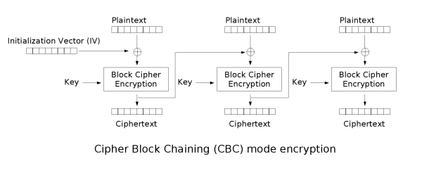
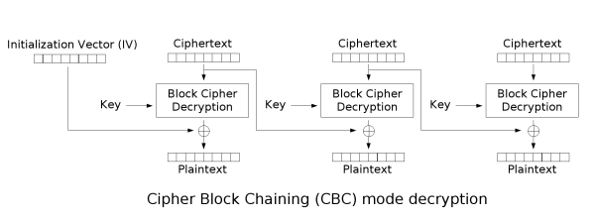
Just for your future reference
Notes:
https://www.adayinthelifeof.nl/wp-content/uploads/2010/12/Cbc_encryption.png
http://i.stack.imgur.com/YHmLn.png

Slide 5
Background - Padding
Why padding?
Plaintext messages come in a variety of lengths.
Block ciphers require all messages to come in an exact number of blocks.
Padding is added into the plaintext, not the ciphertext.

Slide 6
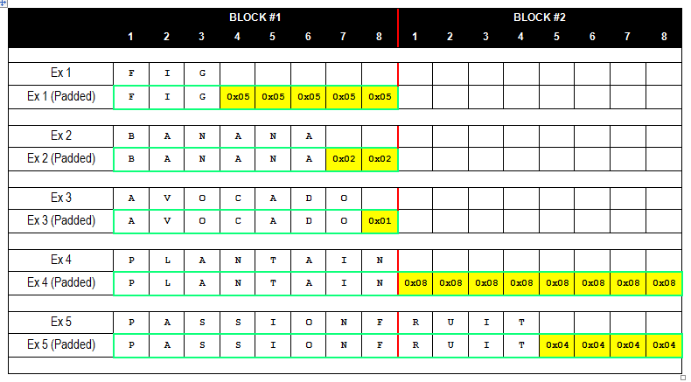
Background - Padding
At least one padding byte is ALWAYS appended
Notes:
3-byte value: padded with Five 0x05
7-byte value: padded with One 0x01
8-byte value: padded with Eight 0x08

Slide 7

Background – Padding + Oracle
The final decrypted block should end with:
A single 0x01 byte (0x01)
Two 0x02 bytes (0x02, 0x02)
Three 0x03 bytes (0x03, 0x03, 0x03)
Four 0x04 bytes (0x04, 0x04, 0x04, 0x04)
...and so on
If not, most cryptographic providers will throw an invalid padding exception.
This extra information is called Oracle.

Slide 8

A Basic Padding Oracle Attack Scenario
An application uses a query string parameter
to pass the encrypted username, company id, and role id of a user
http://sampleapp/home.jsp?UID=7B216A634951170FF851D6CC68FC9537858795A28ED4AAC6
Ciphertext in ASCII Hex representation, 24bytes.
Plaintext: BRIAN;12;2;
Notes:
How do you know the block size?
Then initialization vector

Slide 9
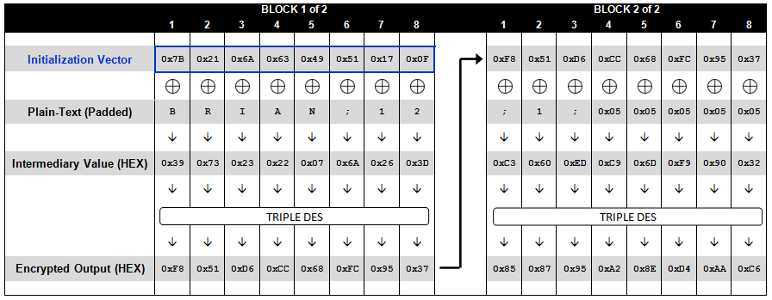
Understand the whole process for the correct plaintext
Encryption Diagram

Slide 10
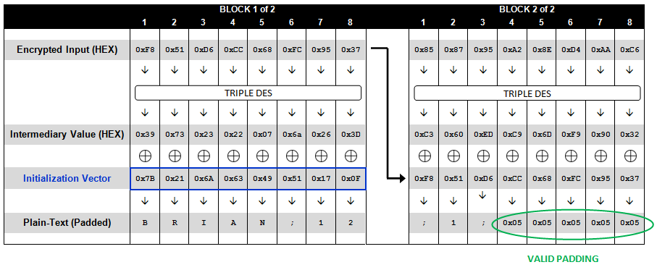
Understand the whole process for the correct plaintext
Decryption Diagram

Slide 11
The Padding Oracle in Web Apps
When the application receives an encrypted value, it responds in one of three ways:
When a valid ciphertext is received (one that is properly padded and contains valid data) the application responds normally (200 OK).
When an invalid ciphertext is received (one that, after decrypted, does not end with a valid padding) the application throws a cryptographic exception (500 Internal Server Error, or 403…).
When a valid ciphertext is received (one that is properly padded) but decrypted to an invalid value, the application displays a custom error message (404 Not Found).
We can distinguish valid padding or not.

Slide 12
Know our attack goal and resources
Our goal: decrypt the value by using padding oracle attack.
Moreover, we have the padding oracle information that server will respond.
?
?
?
?
?
?

Slide 13
The Overview of the PO Attack
The attack trick: isolate each block and try to only decrypt this block of plaintext.
??? Fixed, but we don’t know.
Need to change it now.
??? Fixed, but we don’t know.
This will also change. Server will tell us when it is valid.

Slide 14
The Overview of PO Attack
If we can change them to this status:
Get 0xN：
0xM: we try and know
0x01: server tells us
Get one byte:
= 0xN XOR 0x3D
??? Fixed, but we don’t know.
0xN
0x00 0x00 0x00 0x00 0x00 0x00 0x00 0xM
0x?? 0x?? 0x?? 0x?? 0x?? 0x?? 0x?? 0x01
Valid Padding

Slide 15
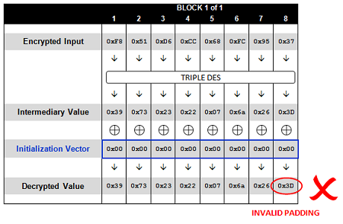
Recap the detailed attack steps
First try from 0 (an IV of all NULL values):
Request:http://sampleapp/home.jsp?UID=0000000000000000F851D6CC68FC9537
Response: 500 - Internal Server Error

Slide 16
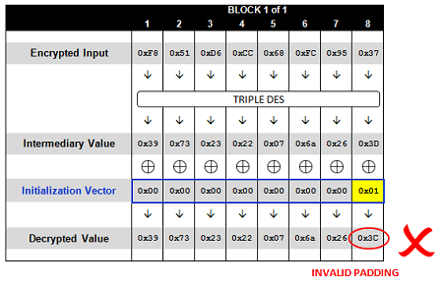
Recap the detailed attack steps
Second try is 1:
Request:http://sampleapp/home.jsp?UID=0000000000000001F851D6CC68FC9537
Response: 500 - Internal Server Error

Slide 17
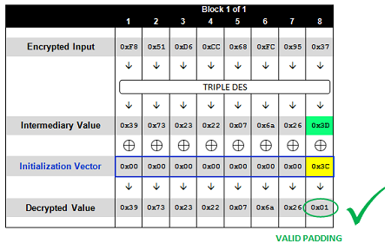
Recap the detailed attack steps
Until this try:
Request:http://sampleapp/home.jsp?UID=000000000000003CF851D6CC68FC9537
Response: 200 OK

Slide 18
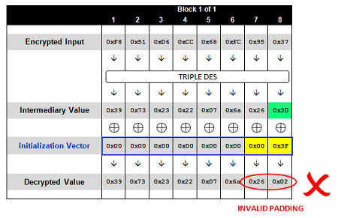
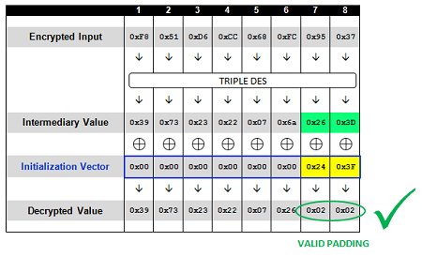
Recap the detailed attack steps
Decrypt the second byte in the same way:

Slide 19
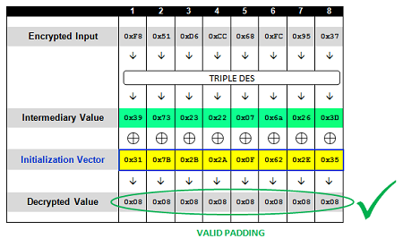
Recap the detailed attack steps
Then we can decrypt all intermediary values:

Slide 20
Recap the detailed attack steps
Finally recover the plaintext for the first block

Slide 21
Then move to the next block
Isolate the second block
Our IVs
Get the intermediate values: using our own IVs
Obtain the plaintext: combine with the previous ciphertext

Slide 22
Automate the PO Attack By PadBuster
An open source tool by Brian Holyfield
https://github.com/GDSSecurity/PadBuster
Written in Perl, thus requiring the Perl environment.
Attack the previous example:
Separated into two lines
URL
padBuster.pl http://sampleapp/home.jsp?UID=7B216A634951170FF851D6CC68FC9537858795A28ED4AAC6
7B216A634951170FF851D6CC68FC9537858795A28ED4AAC6 8 -encoding 2
Encrypted Sample
Block Size
0: Base64 (default)
1: Lowercase HEX ASCII
2: Uppercase HEX ASCII

Slide 23
Exercises
Combine this PPT and a document:
lab1_exercises.docx
Write your answer into this document.
Please hand in a hard copy of all exercise answers!

Slide 24
Exercise #1
Describe padding oracle attack in one sentence (5 marks).
Use your own words to describe the essence of the attack.

Slide 25
Exercise #2
After obtaining this status, what is the next value of Initialization Vector we should try?
Answer it with reasons. (5 marks)
Next value should try?

Slide 26
Exercise #3-1
Decrypt the ciphertext. (5 marks)
http://x.ozetta.net/lab/decrypt_me.php (prepared by Zetta KE and Anthony LAI from VXRL last year)
It will redirect you to a link with a random ciphertext, e.g., http://x.ozetta.net/lab/decrypt_me.php?cipher=9f5756b0bb7b46a82c07280fa9e1ae6040312108d3011654
Backup server: http://www2.comp.polyu.edu.hk/~sccomp444/lab2/
Write the PadBuster command and obtain your own plaintext.
For more hints, see lab1_exercises.docx.

Slide 27
For Exercise #3, you may choose either 3-1 or 3-2, the next one.

Slide 28
Exercise #3-2
Decrypt the ciphertext. (5 marks)
See https://class.coursera.org/crypto-preview/quiz/attempt?quiz_id=123
Target: http://crypto-class.appspot.com/po?er=f20bdba6ff29eed7b046d1df9fb7000058b1ffb4210a580f748b4ac714c001bd4a61044426fb515dad3f21f18aa577c0bdf302936266926ff37dbf7035d5eeb4
Decrypt it using PadBuster, instead of coding a new one.
The decrypted message may seem a bit strange to you. but if you Google it, you will see that it is a famous cryptographic sentence. ☺

Slide 29
Exercise #4
Draw the cipher block graphs (10 marks)
We’re given web server logs that appear to show an attacker exploiting a vulnerability.
https://raw.github.com/SaveTheRbtz/crypto-class/master/ex4/proj4-log.txt
Read this blog post and analyze how he captures the secret.
http://hackeroutfit.wordpress.com/2012/07/06/oracle-padding-attack-challenge/
Your task: draw two complete cipher block graphs to explain his procedure.
One to obtain all Intermediary Values (HEX)
One to obtain the stolen secret (Plaintext)

Slide 30
Thanks to: (References)
http://blog.gdssecurity.com/labs/2010/9/14/automated-padding-oracle-attacks-with-padbuster.html
Nearly all materials are based on it.
I just organize them and sometimes add my own thoughts.
The content, answer sheet of Exercise #3-1 and the decrypt_me.php script are prepared by Zetta KE (ozetta@vxrl.org) and Anthony LAI (darkfloyd@vxrl.org) from VXRL.

